Slide 1
FINAL-YEAR DISSERTATION · BSc (Hons) · NIBM / COVENTRY UNIVERSITY
A Survival-Analysis Framework for Predicting and Explaining Time-to-Employment for Final-Year IT Undergraduates in Sri Lanka
M.S.F. Shazna
Supervisor: L. S. Chathurika
School of Computing and Engineering
885
245
324
295
graduates modelled
employers
real job ads
automated tests
Notes:
Introduce yourself and the title in one breath. Then the 30-second pitch: about 17,000 IT graduates a year, nobody can see how long THEIR search will take, so I built an explainable survival-analysis system trained on 885 real graduates, with employer and job-ad data, tested against ChatGPT, with a working app.

Slide 2
The story in six steps
ROADMAP
1
Problem & gap
2
Method & data
3
Models & evaluation
Why this research?
How it was built
How it was tested
4
Results
5
The artifact
6
Reflection
What was found
App, ChatGPT, usability
Limits, contribution, next
M.S.F. Shazna · Time to First IT Job · NIBM / Coventry
2
Notes:
Give the panel the map so they know where each of their likely questions will be answered. Takes 20 seconds.

Slide 3
The problem: no graduate can see their own timeline
PROBLEM
17,000
1 in 4
Rates only
IT & computing graduates a year in Sri Lanka (SLASSCOM, 2024)
still searching when surveyed: they are 'not yet', not 'failed'
national data report unemployment rates, not individual time to a first job
What a final-year student actually faces today
▪ No personal estimate: 'How long will I take?' is answered with guesses and averages
▪ Existing tools: classify 'employable / not', or match jobs: they ignore WHEN, and discard graduates still searching
▪ Generic AI advice: ChatGPT can talk about careers, but is it right for Sri Lankan graduates? (tested later in this talk)
M.S.F. Shazna · Time to First IT Job · NIBM / Coventry
3
Notes:
About 17,000 IT and computing graduates a year (SLASSCOM 2024). National statistics give unemployment rates, not individual timelines. Existing tools predict a category or match jobs. Quote Kelaniya 2022: the average search is about 8 months for all faculties. The graduate has nothing personal to plan with.

Slide 4
Why survival analysis? Because 'still searching' is information
PROBLEM
Graduate A
found an IT job at month 2
Graduate B
found an IT job at month 4
Graduate C
still searching at survey (month 6) → censored
Graduate D
found an IT job at month 3
Graduate E
still searching at survey (month 8) → censored
Graduate F
found an IT job at month 5
0
2
4
6
8
10
Months after degree completion
A classifier discards C and E, or mislabels them. Survival analysis uses them, and predicts WHEN, not just whether.
M.S.F. Shazna · Time to First IT Job · NIBM / Coventry
4
Notes:
This is the key idea. Six example graduates. Four found a job at the months shown. Two were still searching when surveyed: they are CENSORED. We know they had NOT found a job by then, so their partial information is valuable. A classifier would throw them away or label them 'unemployed', which is wrong. Survival analysis uses exactly this partial information, and also answers WHEN, not just whether.

Slide 5
Literature gap: nothing combines these capabilities
PROBLEM
Capability | Rukais et al. 2025 | ITConnect | Scopira | Commercial tools | This study
Sri Lankan IT focus | Yes | Yes | No | No | Yes
Predicts time to a job | No | No | No | No | Yes
Uses graduates still searching | No | No | No | No | Yes
Range with uncertainty | No | No | No | No | Yes
Individual explanation + what-if | No | No | Partial | Partial | Yes
Closest local precedent: Rukais et al. (2025), an ensemble model over 820 IT employee profiles that predicts a career-path category, not time.
Gap: an explainable, time-to-event framework for Sri Lankan IT graduates, linked to real employer demand, and tested against a general LLM.
M.S.F. Shazna · Time to First IT Job · NIBM / Coventry
5
Notes:
Compare the closest existing work. Rukais et al. 2025 is the strongest Sri Lankan ML precedent but it predicts a career-path CATEGORY with an ensemble. ITConnect detects fake jobs. Scopira and commercial tools are not time-to-event and not Sri Lankan IT specific. None predicts time, none uses censored graduates, none gives a range with uncertainty. This is the gap. Be careful to say 'in my literature review', not 'nowhere in the world'.

Slide 6
Objectives, research questions, and how each is answered
PROBLEM
 | Research question | Answered by
O1 / RQ1 | Which academic, technical, professional and experiential factors are associated with time-to-employment? | Kaplan-Meier, log-rank, Cox / AFT time ratios
O2 / RQ2 | How well do graduate profiles align with employer requirements and job-market demand? | Graduate vs employer ratings, 324 job ads
O3 / RQ3 | How accurately can a survival framework predict time-to-employment, and how do linear, regularised, parametric and nonlinear models compare? | 7 models, locked test set, calibration, fairness
O4 / RQ4 | Does the prototype give accurate, explainable, actionable guidance (usability and a benchmark against a general LLM)? | SUS with 12 users, ChatGPT benchmark
M.S.F. Shazna · Time to First IT Job · NIBM / Coventry
6
Notes:
One research question per objective, numbered the same. The right-hand column is where the evidence lives; you can point to the slide. O4 includes the benchmark against a general-purpose LLM because that is the critique the panel is most likely to raise.

Slide 7
Research design at a glance
METHOD
1
Collect
2
Clean & audit
3
Split once
4
Fit 7 models
graduates, employers, job ads
rules fixed, every removal logged
70 / 15 / 15, stratified
on training only
5
Select
6
Test once
7
Explain
8
Deploy
pre-set rule on validation
locked, never re-tuned
time ratios, what-ifs
app + API, nothing stored
▪ Pragmatist philosophy, deductive and quantitative; the plan, metric and selection rule were fixed before analysis
M.S.F. Shazna · Time to First IT Job · NIBM / Coventry
7
Notes:
Philosophy: pragmatism. Approach: deductive and quantitative. The pipeline is fixed and reproducible: data come in, are cleaned and audited, split ONCE into train / validation / test, seven models are fitted, one is chosen on validation by a rule set in advance, the test set is evaluated once, and the result feeds the app. Every step is in code and re-runs with one command.

Slide 8
Data: three sources, triangulated
METHOD
1,175
245
324
graduate responses (47 items): outcome + profile + 26 skill ratings
employer responses (21 items): importance of skills and hiring factors
real entry-level IT job ads from 211 employers (12 Jul - 11 Oct 2026)
▪ Primary + secondary: questionnaires (Google Forms) plus real job advertisements
▪ Sampling: purposive, convenience and snowball: non-probability, because no sampling frame of IT graduates exists
▪ Sample size: Cochran's formula n = Z²p(1-p)/e² = 384 (95%, ±5%, p = 0.5) → target about 400; collected 1,175
▪ Ethics: ethical approval before collection; consent on every response; no names or contacts; Sri Lanka PDPA 2022
M.S.F. Shazna · Time to First IT Job · NIBM / Coventry
8
Notes:
Primary data: a 47-item graduate questionnaire and a 21-item employer questionnaire, both on Google Forms. Secondary data: 324 real entry-level job ads (topjobs.lk, ITPro.lk, LinkedIn) coded to the same 26-skill vocabulary. Sampling is non-probability (purposive, convenience, snowball) because no list of IT graduates exists; I state that as a limitation. Cochran gives 384 at 95% / 5%, so the target was about 400.

Slide 9
Instrument quality: validity and reliability
METHOD
α 0.925
α 0.902
KMO 0.95
HTMT 0.68
technical skills (17 items), 95% CI 0.916-0.933
soft skills (9 items), 95% CI 0.890-0.913
sampling adequacy of both skill blocks
below 0.85: technical and soft skills are distinct
▪ Content validity: 6 experts (2 lecturers, 1 survival-analysis researcher, 3 practitioners) + a per-item evidence matrix
▪ Pilot: 21 graduates and 9 employers, run before the main survey
▪ Construct validity: factor analysis (parallel analysis), AVE, Fornell-Larcker, HTMT
▪ Reliability: Cronbach's alpha with Feldt CIs, and omega; attention-check item Q18 removed 24 careless responses
M.S.F. Shazna · Time to First IT Job · NIBM / Coventry
9
Notes:
Content validity: 6 experts (two lecturers, one survival-analysis researcher, three industry practitioners) and a per-item evidence matrix. Pilot with 21 graduates and 9 employers. Construct validity on the skill blocks: KMO above 0.94, parallel analysis, discriminant validity by HTMT below 0.85. Reliability: Cronbach's alpha 0.925 and 0.902 with confidence intervals, omega the same. An attention-check item removes careless responders.

Slide 10
From 1,175 responses to 885 modelled graduates
METHOD
1,175
raw responses
1,147
after quality checks
(−4 duplicates, −24 failed attention check)
917
after setting aside
230 final-year students (no outcome yet)
885
modelling graduates
(−32 outside eligibility / not in IT job market)
667 found a job
218 still searching
24.6% censored
M.S.F. Shazna · Time to First IT Job · NIBM / Coventry
10
Notes:
The cleaning rules were fixed before looking at results and every removal is in the data-cleaning log. 4 duplicates and 24 failed attention checks. 230 final-year students are set aside because they have no outcome yet (they feed descriptive analyses). 32 more removed for rules like no IT job market, implausible dates. Result: 885 graduates, 667 found an IT job, 218 still searching, so 24.6% censored.

Slide 11
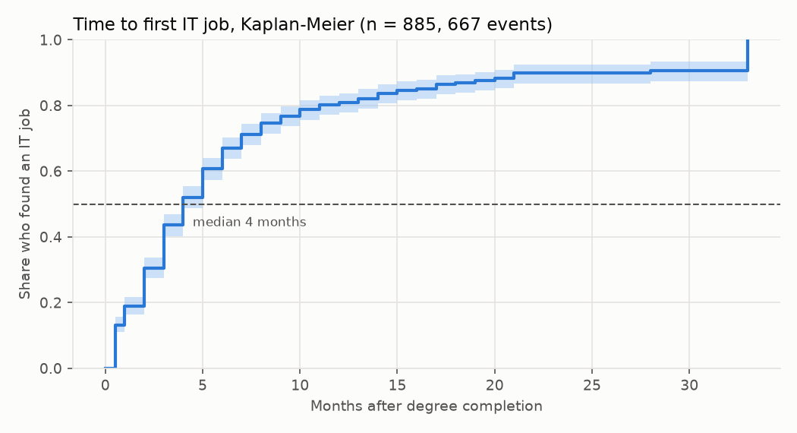
What the data show: most find work within a few months
RESULTS
43.6%
67.0%
found a job by 3 months
by 6 months
80.9%
89.8%
by 12 months
by 24 months
Median 4 months · 117 graduates (13.2%) started before completion
Train / validation / test were alike: 24.7% / 24.8% / 24.2% still searching
M.S.F. Shazna · Time to First IT Job · NIBM / Coventry
11
Notes:
Kaplan-Meier on the 885 graduates: 43.6% had found an IT job by 3 months, 67.0% by 6, 80.9% by 12, 89.8% by 24. The median is 4 months, and 117 graduates (13.2%) started an IT role before completion. The training, validation and test sets were similar on every characteristic, so the split is fair.

Slide 12
Seven survival models, one pre-set selection rule
MODELS
Family | Model | Why it is here
Linear | Cox Proportional Hazards | Standard baseline; hazard ratios; no distribution assumption
Regularised | Elastic Net Cox | Shrinks coefficients; guards against overfitting
Parametric | AFT: Weibull, Log-Normal, Log-Logistic | Models time directly; time ratios are easy to explain
Nonlinear | DeepSurv (neural network) | Learns nonlinear patterns; the supervisor asked for a DNN
▪ Selection rule (fixed beforehand): highest validation Uno's C; simplicity and calibration break near-ties
▪ Excluded by design: random forests and ensembles (explainability for individuals; supervisor requirement); enforced by a test
▪ Guard rails: 29.2 events per parameter; elastic-net penalty; early stopping for DeepSurv
M.S.F. Shazna · Time to First IT Job · NIBM / Coventry
12
Notes:
Models span the supervisor's families: linear (Cox PH), regularised (Elastic Net Cox), parametric (three AFT distributions plus the best by AIC) and nonlinear (DeepSurv, a neural-network survival model). No forests or ensembles, as the supervisor directed, and a test in the code enforces it. The selection rule was fixed in advance: highest validation Uno's C, simplicity and calibration as tie-breakers.

Slide 13
Evaluation protocol: the test set was used once
MODELS
Training: 620
Validation: 133
Test: 132
fit models, tune by cross-validation
choose the model
used ONCE
▪ Stratified 70 / 15 / 15: by outcome; no graduate in two parts
▪ No leakage: imputation, scaling, encoding learned on training only
▪ Test locked: evaluated once; never used to choose or tune
Metric | What it tells you
Uno's C-index | ranking: who finds work first (0.5 = chance)
Integrated Brier score | error of predicted probabilities
Calibration (3/6/12 m) | do predicted % match reality?
Fairness, robustness | by gender, institution type, data choices
M.S.F. Shazna · Time to First IT Job · NIBM / Coventry
13
Notes:
70/15/15 stratified by outcome; no graduate appears in two parts. Train is for fitting and cross-validated tuning. Validation is for choosing the model. Test is for a single final evaluation. Preprocessing (imputation, scaling, encoding) is learned from training data only, which prevents leakage. Metrics: Uno's C (designed for censored data), integrated Brier score, calibration at 3, 6 and 12 months.

Slide 14
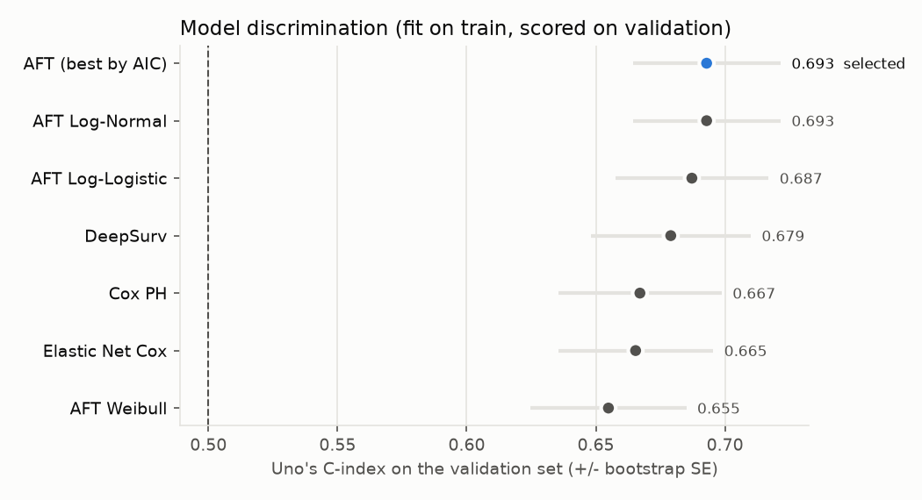
Validation: AFT Log-Normal selected (Uno's C 0.693)
RESULTS
Model | Uno's C | IBS
AFT Log-Normal ✔ | 0.693 | 0.171
AFT Log-Logistic | 0.687 | 0.171
DeepSurv | 0.679 | 0.175
Cox PH | 0.667 | 0.179
Elastic Net Cox | 0.665 | 0.175
AFT Weibull | 0.655 | 0.179
Validation set, 133 graduates. Intervals overlap, so simplicity and calibration decide near-ties.
0.693 is VALIDATION (used to choose the model). The unbiased TEST result is 0.619, next slide.
M.S.F. Shazna · Time to First IT Job · NIBM / Coventry
14
Notes:
On the 133 validation graduates the AFT Log-Normal had the highest Uno's C: 0.693 (95% CI 0.636 to 0.745) and a low integrated Brier score of 0.171. DeepSurv reached 0.679, Cox PH 0.667. The intervals overlap, which is why the rule also uses simplicity. The more complex neural survival models did not beat it, which is why I did not tune towards a target number.

Slide 15
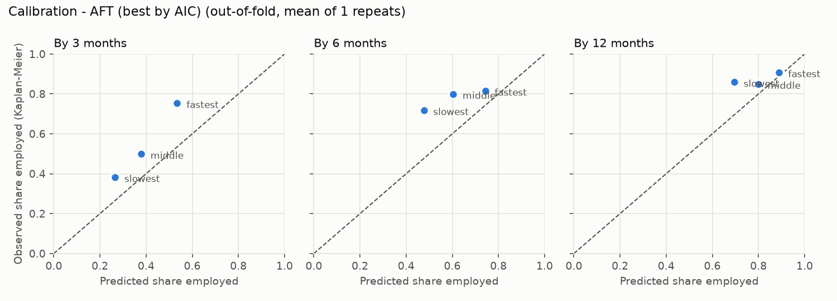
The locked test result: honest and moderate
RESULTS
0.619
~62/100
Uno's C (95% CI 0.557-0.683)
pairs ranked correctly (Harrell 0.626)
0.167
−17 pts
IBS (Kaplan-Meier baseline 0.164)
predicted 61% vs observed 77% by 6 months
▪ Why 0.619, not 0.693: 0.693 was the validation score used to CHOOSE the model; 0.619 (about 0.62) is the unbiased test score. A drop is expected, and the intervals overlap
▪ Reading it: the ranking works; the probabilities are too pessimistic (small sets, faster later cohorts)
▪ What I did: reported it, did not re-tune on the test set; the app shows a range first and labels probabilities as indicative
M.S.F. Shazna · Time to First IT Job · NIBM / Coventry
15
Notes:
Test set of 132 graduates, evaluated once. Uno's C 0.619 (95% CI 0.557 to 0.683), Harrell's C 0.626. Integrated Brier 0.167 against 0.164 for the Kaplan-Meier baseline, so the probabilities are not better than a baseline. The model under-predicts employment: 61% predicted versus 77% observed by 6 months. Plausible causes: small evaluation sets, later cohorts finding jobs faster, one reference survey date. I report this rather than re-tune on the test set. That is why the app leads with a range and labels probabilities as indicative.

Slide 16
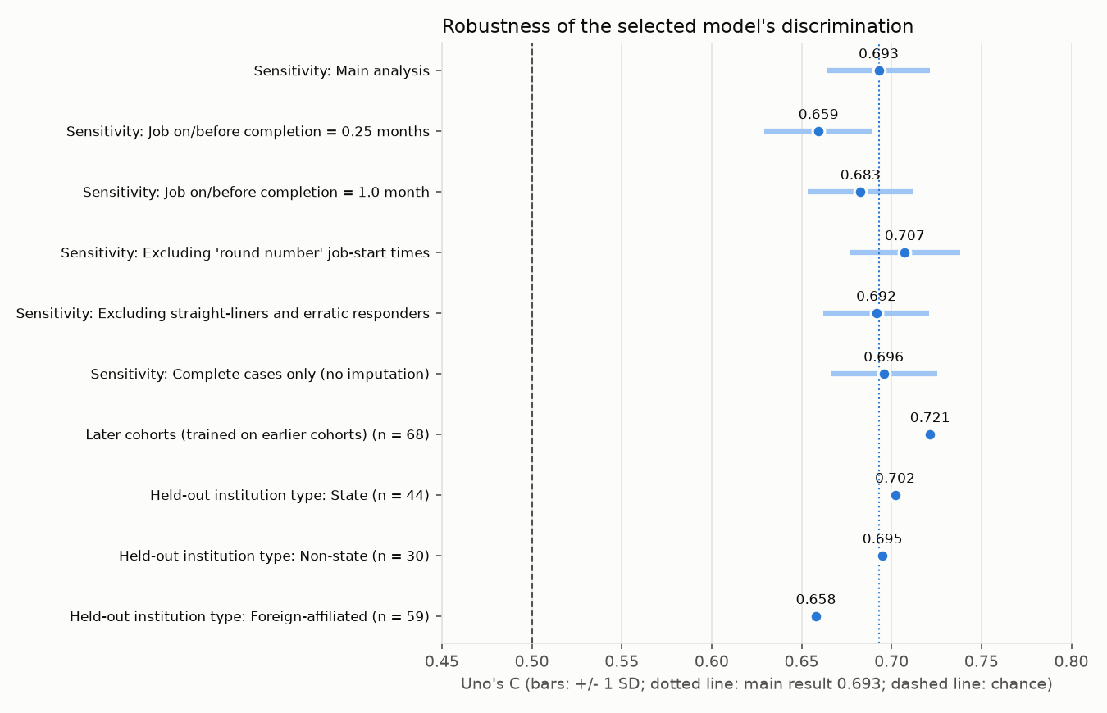
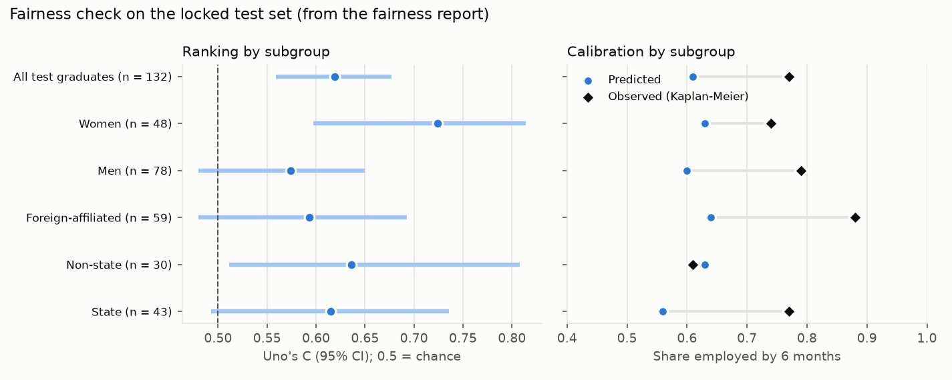
Is it fair and robust? Checks on the locked test set
RESULTS
0.724 vs 0.574
0.659 - 0.707
C 0.72
women vs men Uno's C; intervals overlap; gender never a model input
validation C across data-cleaning variants (main 0.693)
trained on earlier cohorts, tested on later ones
M.S.F. Shazna · Time to First IT Job · NIBM / Coventry
16
Notes:
Fairness: Uno's C and calibration by gender and institution type. Women 0.724 versus men 0.574, but the intervals overlap, so the gap may be chance. Gender is never a model input; it is used only for this check. Institution type is an input but showed no clear association. Robustness: validation C ranged only from 0.659 to 0.707 across the data-cleaning variants, and 15 of 16 effect directions stayed the same in the complete-case check. Temporal validation: trained on earlier cohorts, tested on later cohorts, C 0.72.

Slide 17
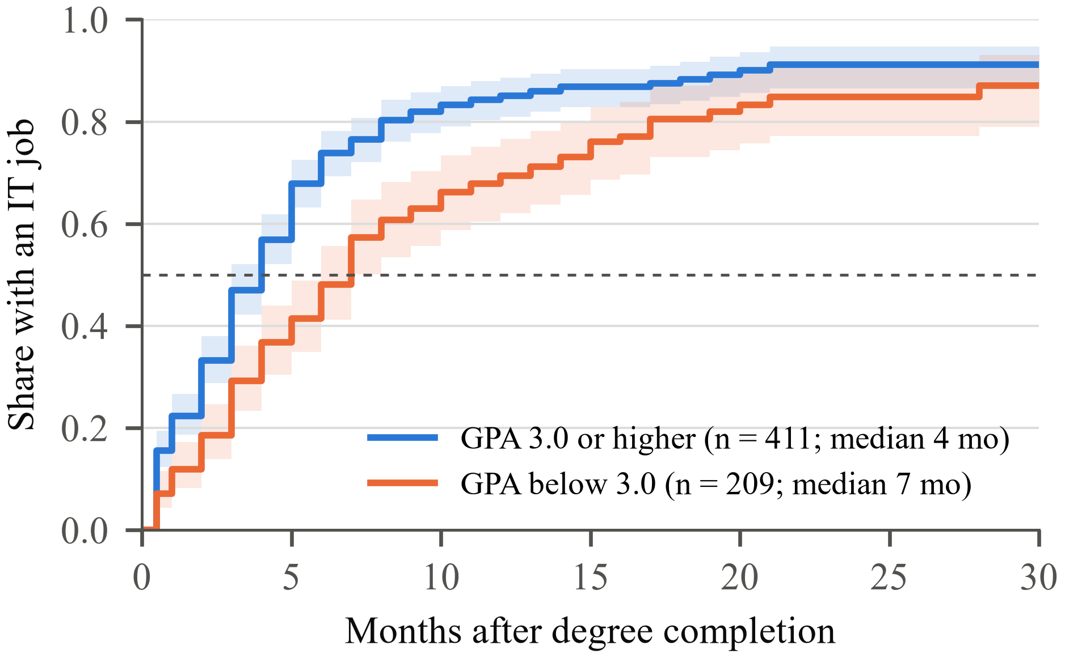
RQ1: GPA and internships are linked to a faster first job
RESULTS
Time ratio per 1 SD (95% CI): left of 1 = shorter search
GPA
0.80
Internship months
0.84
Technical skills
0.92
Certifications
0.95
Portfolio
0.95
Kaplan-Meier by GPA: median 4 months (GPA ≥ 3.0) vs 7 months (below)
Soft skills
0.97
Non-state institution
0.86
−20%
−16%
Hackathons
0.96
search per SD of GPA
per SD of internship
no effect = 1
M.S.F. Shazna · Time to First IT Job · NIBM / Coventry
17
Notes:
Time ratios from the selected AFT model, per standard deviation. A time ratio below 1 means a shorter search. GPA 0.80 means about 20% shorter; internship months 0.84, about 16% shorter. Both clear (p = 0.001). Certifications and technical skills point the same way but their intervals include 1. Institution type, degree programme, soft skills and preparation activities show no clear association. This is observational: associations, not causes. The Kaplan-Meier curves by GPA show the same thing: median 4 months for GPA 3.0 or higher against 7 months below.

Slide 18
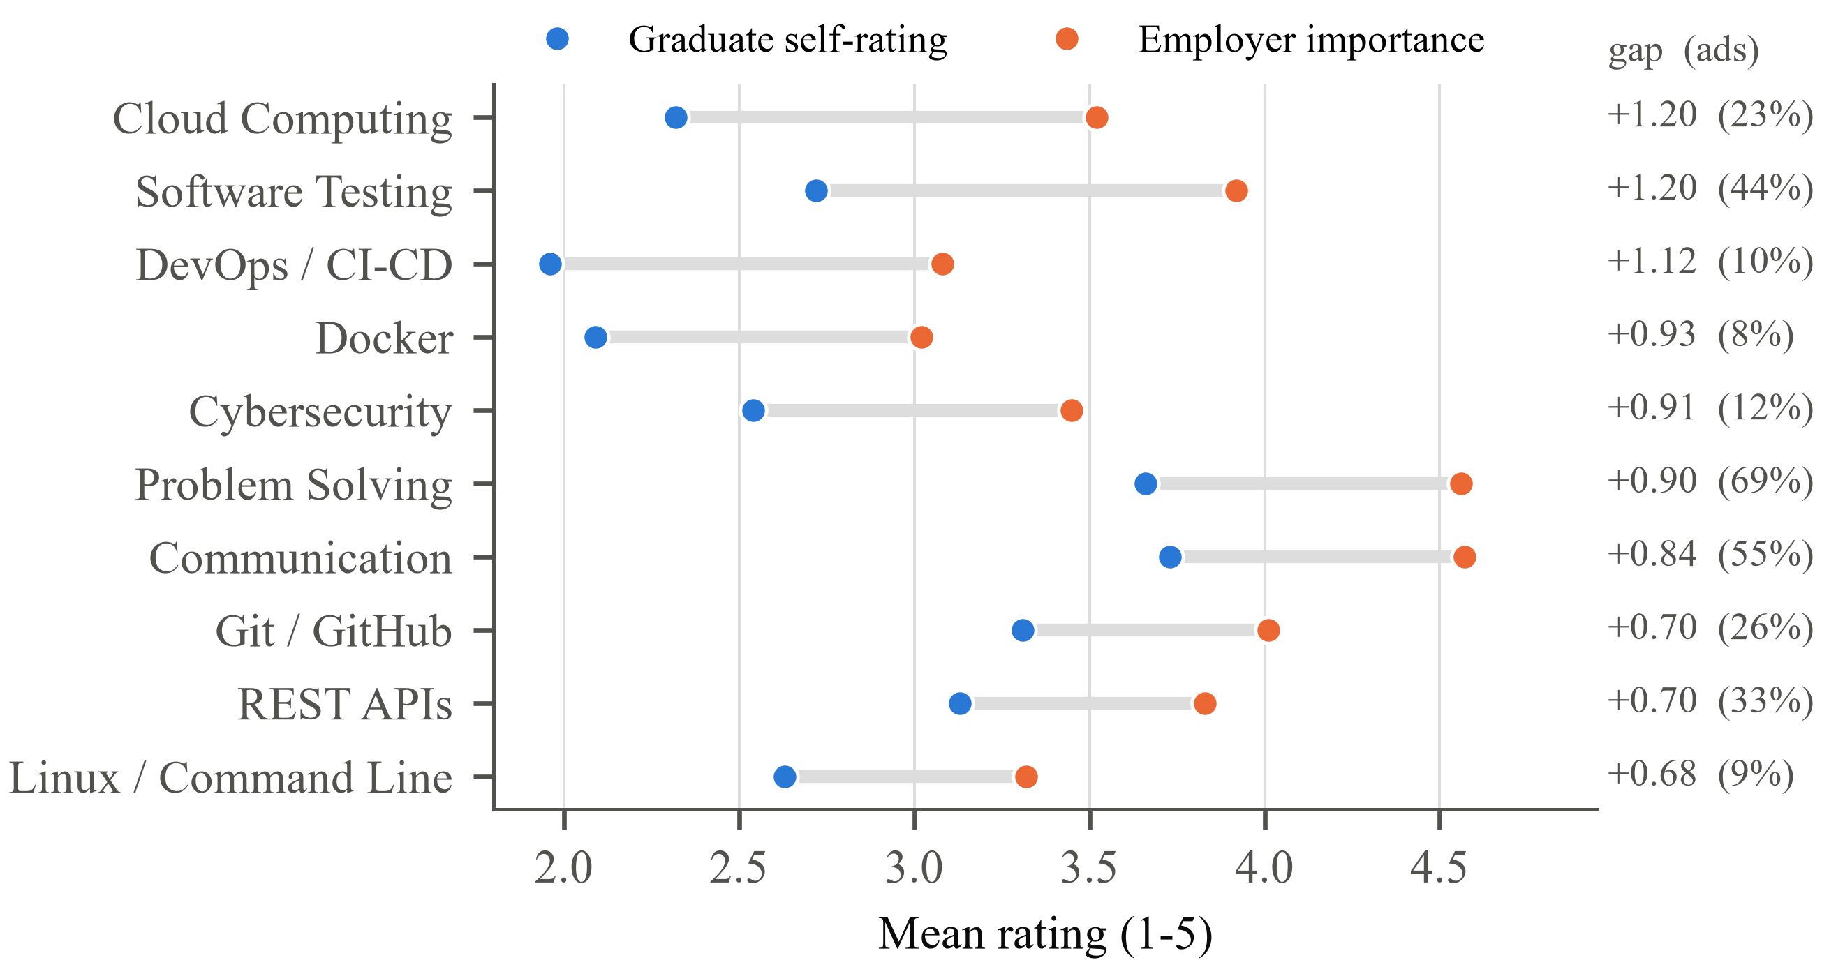
RQ2: graduates fall short of employers on 25 of 26 skills
RESULTS
25 of 26
skills where graduates rate themselves below employers
rho 0.39
employers' stated priorities vs what ads actually ask for
3.21 / 5
employers rate GPA the LEAST important, yet it is the strongest link to speed
M.S.F. Shazna · Time to First IT Job · NIBM / Coventry
18
Notes:
Employers' importance ratings versus graduates' self-ratings. The biggest gaps are cloud computing, software testing, DevOps, Docker and cybersecurity. Problem solving and communication are the most requested in real job ads (69% and 55%) and also show gaps. Employers' stated priorities matched what they advertise only moderately (Spearman rho 0.39). Employer ratings cluster at 4 and 5, so I used them to rank skills, not as absolute levels. Note GPA: employers rated it least important (3.21 of 5), yet it had the strongest association with speed. Likely a screening signal.

Slide 19
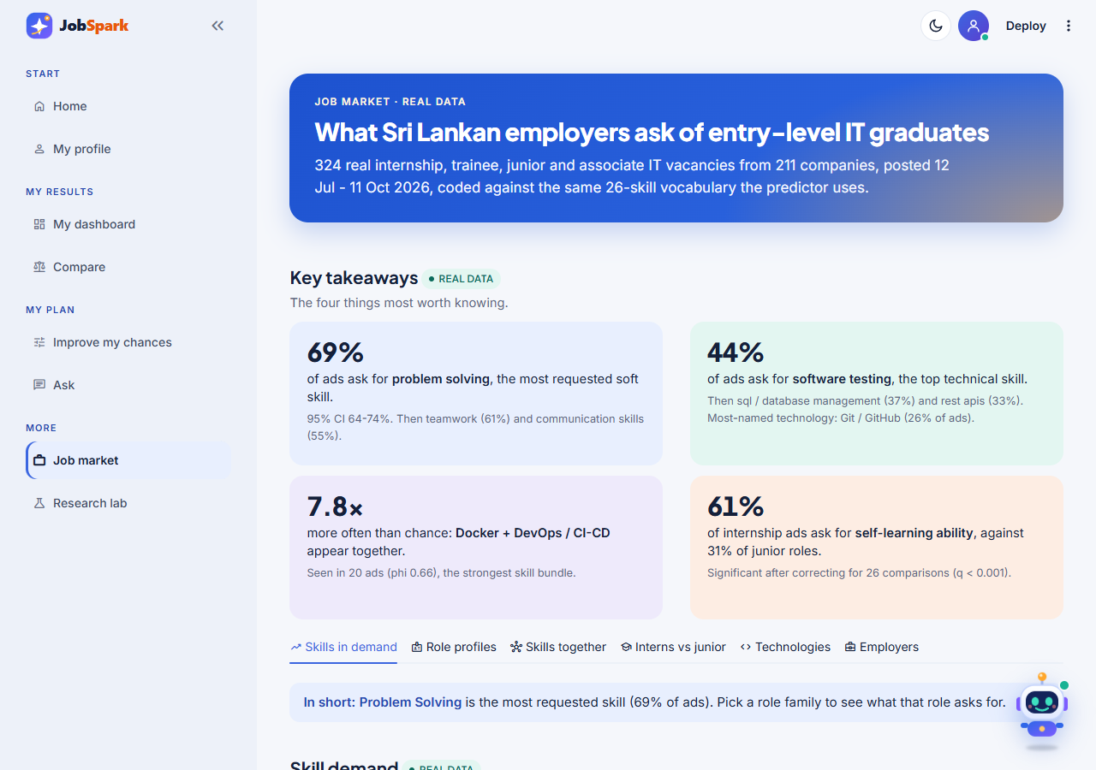
Real job-ad evidence: what employers actually advertise
RESULTS
▪ 324 real ads, 211 companies, 7 role families
▪ Soft skills lead: problem solving 69%, teamwork 61%
▪ Top technical: software testing 44%, SQL 37%
▪ Skill bundle: Docker + DevOps seen 7.8× above chance
▪ Interns: ads stress self-learning, 61% vs 31%
M.S.F. Shazna · Time to First IT Job · NIBM / Coventry
19
Notes:
The Job market page of the app, built from 324 real ads. Problem solving appears in 69% of ads, teamwork 61%, communication 55%. Software testing is the top technical skill at 44%. Docker plus DevOps is the strongest skill bundle, seen together 7.8 times more often than chance. Internship ads stress self-learning (61% against 31% for junior roles), significant after Benjamini-Hochberg correction across 26 skills.

Slide 20
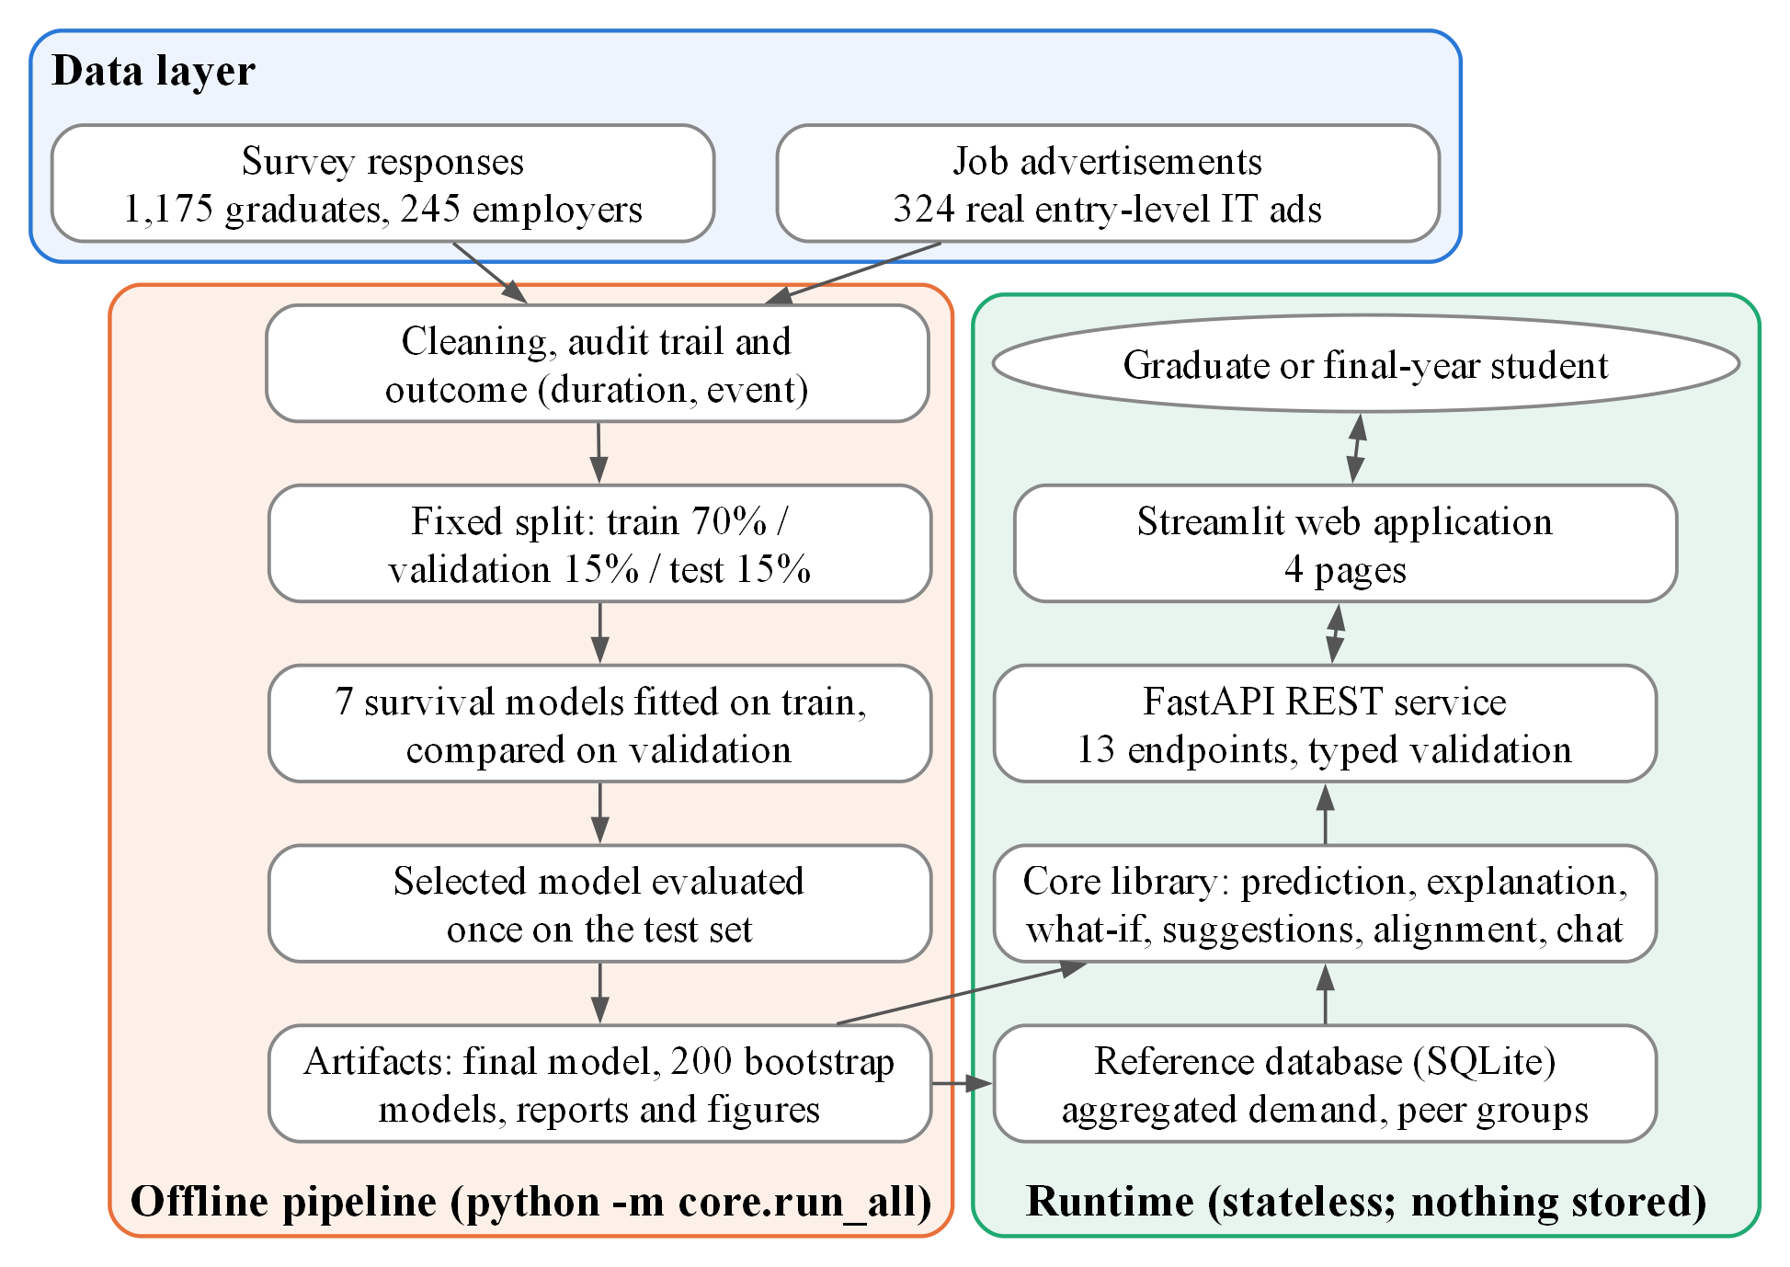
The artifact: an offline pipeline and a stateless app
ARTIFACT
▪ Offline pipeline: clean → split → fit 7 models → select → test once → 200 bootstrap fits
▪ Runtime: FastAPI (13 endpoints) + Streamlit; loads stored results
▪ Privacy by design: no profile is stored (a test checks it)
▪ Reproducible: one command re-runs everything; data fingerprinted
M.S.F. Shazna · Time to First IT Job · NIBM / Coventry
20
Notes:
Two layers. The offline pipeline cleans data, fits and selects models, evaluates once on the test set, builds 200 bootstrap models for uncertainty, and writes every result as an artifact. The runtime layer (FastAPI plus Streamlit) loads those artifacts, predicts, explains and compares skills with real ads. It stores no profile. 13 endpoints, typed validation, 295 tests.

Slide 21
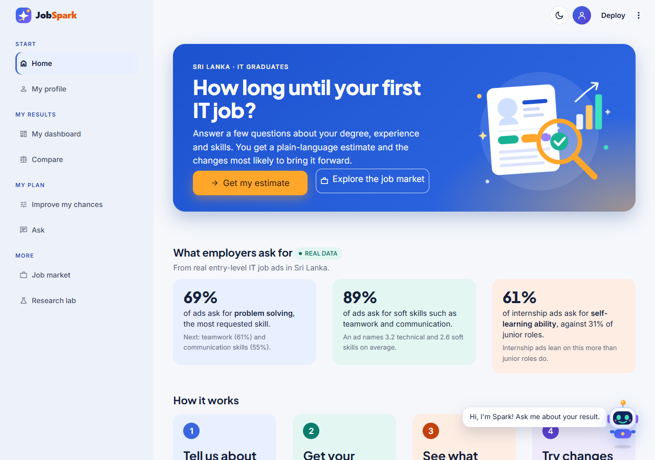
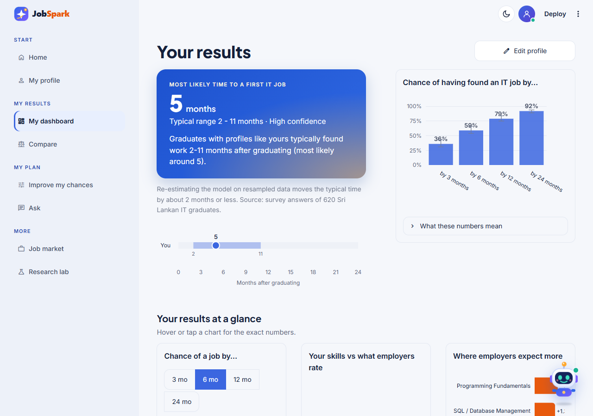
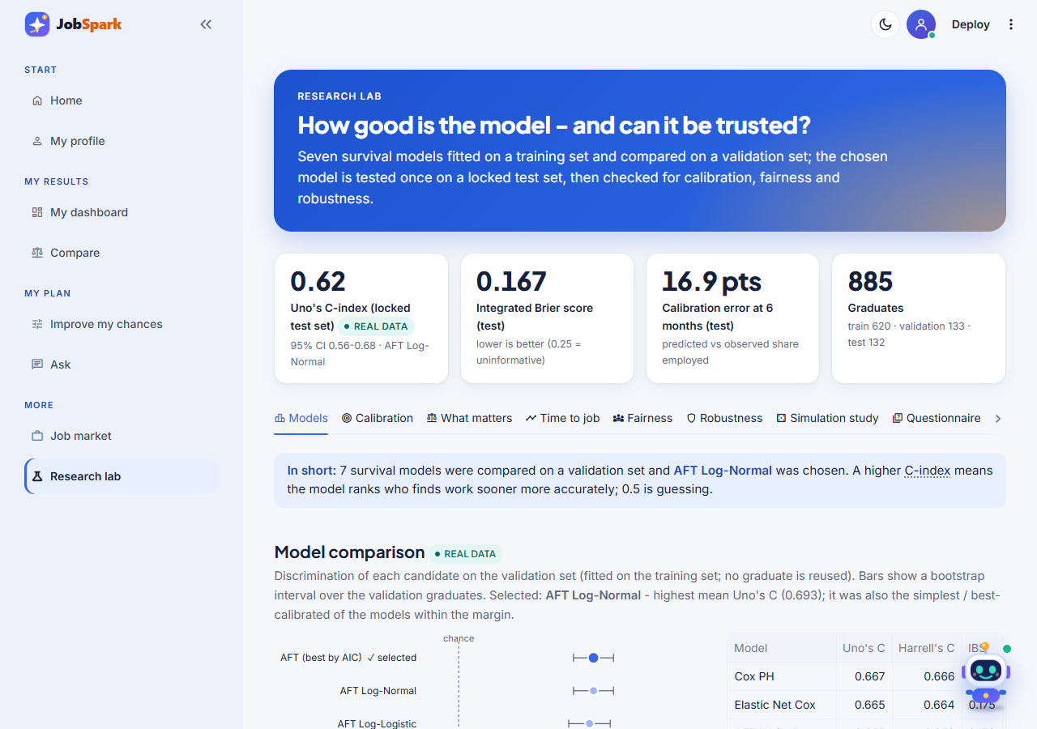
The working prototype: JobSpark, live and tested
ARTIFACT
1 Home | purpose, headline job-ad figures, steps to an estimate
2 My dashboard | most likely time, range, confidence, chance of a job
3 Job market | 324 real ads: skill demand, bundles, roles
4 Research lab | model comparison, calibration, fairness, robustness
M.S.F. Shazna · Time to First IT Job · NIBM / Coventry
21
Notes:
These are screenshots of the real running application, not mock-ups. The app is called JobSpark. Home explains the system and shows headline figures from the real job ads. 'Get my estimate' opens a four-step profile (About you, Experience, Skills, Preparation) and then My dashboard shows the range, the confidence and the chance of a job. Other pages: Compare (skills against employers), Improve my chances (what-ifs), Ask (answers only from the system's own results, also available as the floating Spark assistant), Job market (324 real ads) and Research lab (how good the model is, including its flaws). The interface was redesigned after the usability study; the model, the API and the results did not change. Live demo if asked: start the API (uvicorn api.main:app --port 8000) and the app (streamlit run frontend/app.py), click Get my estimate, accept the default profile (GPA 3.0, 6 months of internship, 3 projects) through the four steps, show the dashboard, then open Improve my chances and move the internship slider. Backup plan: these screenshots.

Slide 22
The dashboard: a range, the chance of a job and a plan
ARTIFACT
1
Most likely time + range + confidence
1
3
'5 months, typical range 2-11, high confidence'
2
Range bar
the middle half of similar graduates, at a glance
3
Chance of a job by 3 / 6 / 12 / 24 months
2
bars with intervals; hover for the exact numbers
4
Results at a glance
chance of a job, skills against what employers rate, where employers expect more
Redesigned after the usability study: step-by-step profile, dashboard, light and dark themes. The model, the API and the results are unchanged.
M.S.F. Shazna · Time to First IT Job · NIBM / Coventry
22
Notes:
This is the real app. (1) The most likely time with a typical range and a confidence label. (2) The range bar. (3) The chance of having found an IT job by 3, 6, 12 and 24 months, with intervals. 'Your results at a glance' compares the profile with employers' ratings. The explanation (what is helping and holding back) and the what-ifs are reached from the same results area and from Improve my chances, shown next. The interface was redesigned after the usability study (step-by-step profile, dashboard, light and dark themes); the model and results did not change. If asked, offer a live demo.

Slide 23
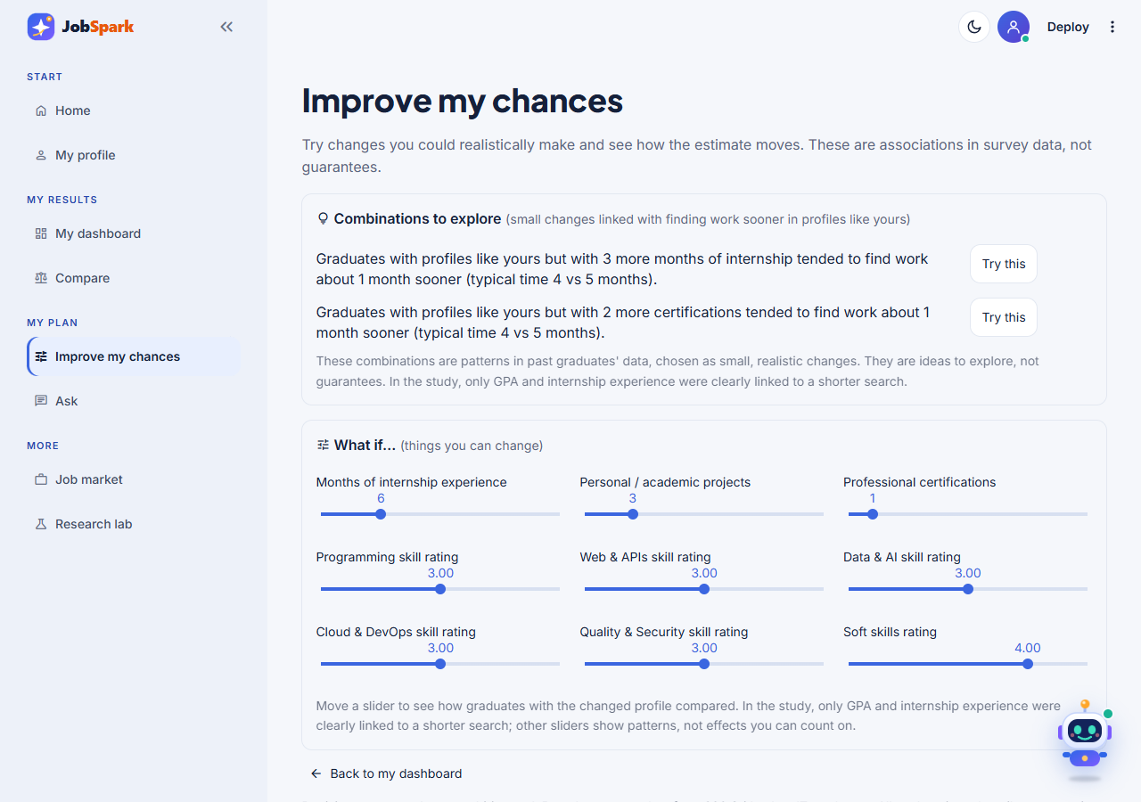
Combinations to explore, and what-if sliders
ARTIFACT
▪ Combinations to explore: small, realistic changes linked with faster searches in profiles like yours
▪ What-if sliders: change internship, projects, certifications, skill ratings and see the range move
▪ Careful wording: 'tended to', never 'will'; patterns, not causes
▪ Honest: the app says only GPA and internship were clearly linked
▪ Grounded assistant (Spark): answers only from the system's own results; nothing stored
M.S.F. Shazna · Time to First IT Job · NIBM / Coventry
23
Notes:
The what-if sliders and the suggested combinations use ASSOCIATIONAL wording: 'graduates with profiles like yours but with 3 more months of internship tended to find work about 1 month sooner'. They never say 'will'. This answers the critique 'so what does a graduate do differently?': they get realistic, small, actionable changes, and the app is honest that only GPA and internship were clearly linked to a shorter search.

Slide 24
Transparency built in: the Research lab
ARTIFACT
▪ Models: all 7 compared, selected one marked
▪ Tabs: calibration, what matters, fairness, robustness, simulation, questionnaire
▪ Real vs synthetic: every figure is tagged
▪ Honest: shows the 16.9-point calibration error
M.S.F. Shazna · Time to First IT Job · NIBM / Coventry
24
Notes:
The app does not just predict, it shows how good the model is and where it fails. The Research lab page shows the model comparison, the locked test result, calibration, fairness, robustness, a simulation study and the questionnaire evidence. This is a direct answer to 'can it be trusted?': the system tells users its own limits.

Slide 25
Why not just use ChatGPT? I tested it
ARTIFACT
0.619
0.539
+0.081
132
this model
ChatGPT (near chance)
difference, 95% CI 0.030-0.131
same test graduates
 | This system | ChatGPT (general LLM)
Trained on | 620 real Sri Lankan graduates, for this one outcome | web text, for general language
Uses graduates still searching | Yes (censoring) | No
Consistency | same profile → same answer | different answers on repeated runs
Bias on the 132 graduates | under-predicts (pessimistic) | over-optimistic within 6 months
Best at | individual, consistent, evidence-based timeline | general advice and wording
M.S.F. Shazna · Time to First IT Job · NIBM / Coventry
25
Notes:
Same 132 held-out test graduates, same information, anonymous profiles. ChatGPT's Uno's C was 0.539, close to chance, against 0.619 for the model; difference 0.081, 95% CI 0.030 to 0.131. It was over-optimistic about employment within six months and gave different answers to the same profile across repeated runs. ChatGPT is a general language model trained on web text, never on Sri Lankan graduate outcomes, and it cannot use people still searching. It is better at general advice and wording. Fair view: complementary, not competing.

Slide 26
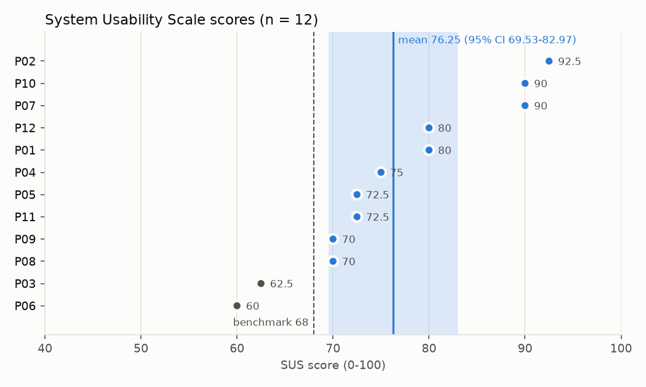
Usability: SUS 76.3 with 12 users, and what changed after
ARTIFACT
What users said | What changed
Main result not obvious (3) | Chat folded away so the estimate stays the focus
Terms and charts need explaining (3) | 'How to read this result' guide added
Navigation inconsistent (2) | Page headings now match the menu
Unsure the numbers apply to them (2) | Data-source line under the estimate
76.3
10 / 12
α 0.90
Honest limits: 12 peers, task completion not recorded, fixes not re-tested.
mean SUS
scored ≥ 68
reliability
M.S.F. Shazna · Time to First IT Job · NIBM / Coventry
26
Notes:
Twelve final-year students and graduates used the app in one-to-one sessions on 14 October. Mean SUS 76.3 (95% CI 69.5 to 83.0) against the benchmark of 68 (Hyzy et al., 2022); ten of twelve scored 68 or more; Cronbach's alpha 0.90. Comments led to real changes. Limitations: participants were peers, n = 12, and task completion was not recorded task by task. The fixes were applied after the study and not re-tested.

Slide 27
Quality and trust: tests, reproducibility, ethics
ARTIFACT
295
1 command
Public
0 stored
automated tests pass
re-runs the whole pipeline
code and walkthrough notebook on GitHub
profiles kept by the app (tested)
▪ Testing: cleaning rules, model interface, API schemas, SUS scoring, privacy guarantee, wording rules
▪ Reproducibility: fixed seeds, data fingerprint, walkthrough notebook that re-computes every reported metric
▪ Ethics: approved before collection; consent; no names or contacts; PDPA 2022; fairness checked; associational wording
▪ Process: pre-set analysis plan; every deviation documented with its reason
M.S.F. Shazna · Time to First IT Job · NIBM / Coventry
27
Notes:
295 automated tests cover cleaning, models, the API and the privacy guarantee (nothing stored). Every number in the thesis can be regenerated: the walkthrough notebook runs every metric, and the code is public on GitHub. Ethics: ethical approval before collection, consent on every response, no identifying questions, PDPA 2022 compliance, institutions reported by type only, and fairness checked. The what-if wording avoids causal claims.

Slide 28
Limitations, stated openly
REFLECTION
Limitation | How it is handled
Non-probability sample; a third from one institution | stated; compared with Kelaniya 2022; results describe this sample
Self-reported outcome and recalled dates | month-and-year questions, impossible dates removed, sensitivity checks
One reference survey date for every response | documented deviation; may overstate follow-up for those still searching
Small evaluation sets (about 130); probabilities pessimistic | reported openly; app leads with a range; labelled indicative
Observational data | associational wording everywhere; no causal claims
Employer ratings cluster at 4-5 | used to rank skills; checked against real job ads
SUS: 12 peers, no task-by-task completion | stated; fixes made but not re-tested
M.S.F. Shazna · Time to First IT Job · NIBM / Coventry
28
Notes:
Be direct about these before the panel raises them. Each has a mitigation in the thesis. The sample is non-probability with about a third from one institution; outcomes and dates are self-reported; one reference survey date was used for every response, which may overstate follow-up for graduates still searching; the evaluation sets are small (about 130) and probabilities are too pessimistic; the study is observational; employer ratings cluster at 4 and 5; and SUS participants were the researcher's peers.

Slide 29
Answers to the research questions, and the contribution
REFLECTION
RQ1
GPA and internship months are linked to 20% and 16% shorter searches; institution and degree type show no clear link
RQ2
graduates rate themselves below employers on 25 of 26 skills; biggest gaps in cloud, testing and DevOps
RQ3
AFT Log-Normal chosen by a pre-set rule; moderate ranking on the locked test (C 0.619); probabilities too pessimistic
RQ4
usable (SUS 76.3) and better than ChatGPT on the same graduates (0.619 vs 0.539)
Contribution: the first explainable survival-analysis system that predicts WHEN Sri Lankan IT graduates find a first IT job, linked to real employer demand and tested against a general LLM.
M.S.F. Shazna · Time to First IT Job · NIBM / Coventry
29
Notes:
Summarise each research question in one line. Then say the contribution in one sentence: the first explainable survival-analysis system that predicts WHEN Sri Lankan IT graduates find a first IT job, triangulated with employer and job-ad data, and tested against a general LLM.

Slide 30
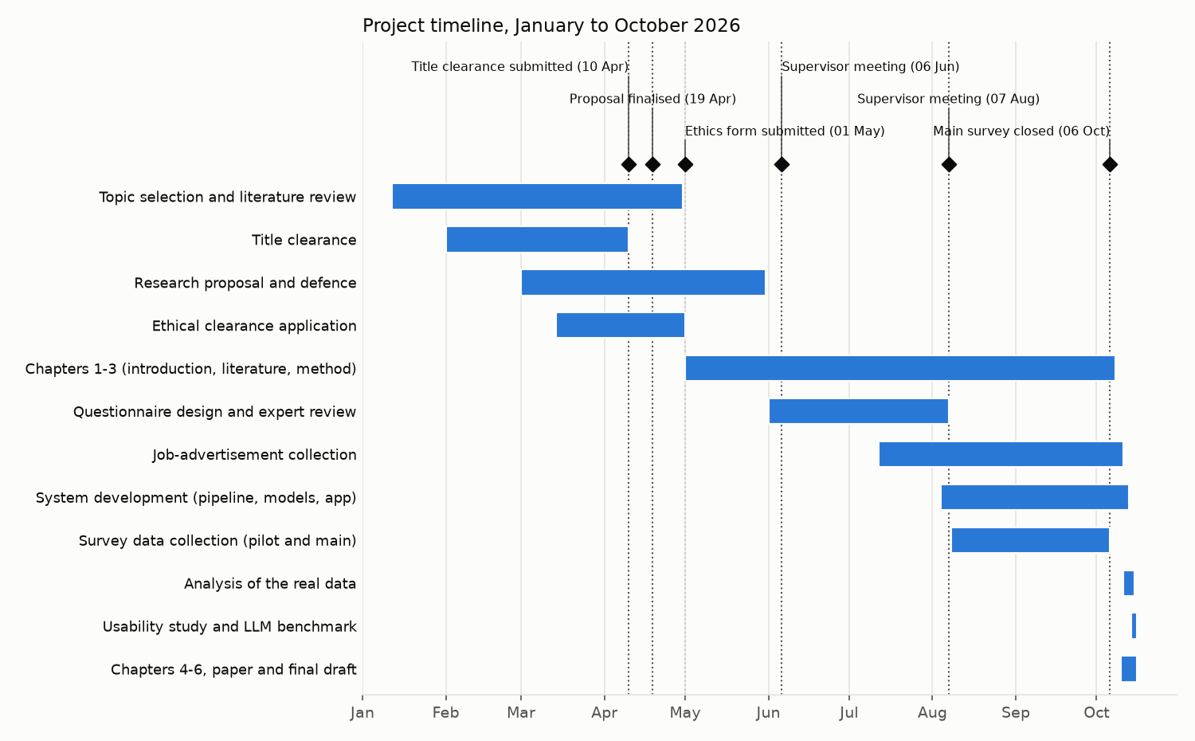
Project journey and what comes next
REFLECTION
Next steps
▪ More data: more respondents and institutions
▪ Recalibrate: fix the pessimistic probabilities
▪ Real dates: per-respondent survey dates
▪ Re-test: the improved app with task-level measures
▪ Track outcomes: follow graduates after using the tool
M.S.F. Shazna · Time to First IT Job · NIBM / Coventry
30
Notes:
The timeline shows how the project ran from January to October 2026: title clearance and proposal February to May, ethics, questionnaire design and job-ad collection overlapping from June, the main survey closing on 6 October, and analysis, the usability study, the LLM benchmark and the thesis completed in the final weeks. Future work: more respondents from more institutions, recalibrate the probabilities, use real per-respondent survey dates, and re-test the improved app.

Slide 31
Four things to remember
WHEN, not just whether
Honest evidence
survival analysis uses the one in four still searching
locked test set used once: C 0.619, reported with its flaws
Beats ChatGPT
Actually built
0.619 vs 0.539 on the same 132 graduates
working app, SUS 76.3, 295 tests, public code
Notes:
Close on the four messages and invite questions. Keep the Viva Sheet open. Evidence if asked: walkthrough notebook, 295 tests, public repository.

Slide 32
Thank you
Questions and discussion
M.S.F. Shazna · Supervisor: L. S. Chathurika
Code, tests and walkthrough notebook: github.com/ShaznaSalman/final-research-employability
Notes:
End here and invite questions. The next two slides are backup only: the hard questions and the key numbers. Remember: 0.62 is the test score, 0.693 the validation score.

Slide 33
Backup: the hard questions, ready
BACKUP
'0.62 is weak'
'It under-predicts'
0.62 is the unbiased TEST score (0.693 was the validation score used to choose the model). Honest, not tuned; contacts and interviews weren't measured; more data adds ~0.01-0.02.
Yes, by up to 17 pts. Small sets and faster later cohorts. Reported, not tuned away; the app leads with a range.
'Why not ChatGPT?'
'Will it get me a job?'
Tested on the same 132 graduates: 0.539 vs 0.619, and inconsistent across runs.
No promise. It shows a realistic timeline and which changeable factors went with faster hiring.
'Biased sample?'
'Why no Random Forest?'
Non-probability, stated. Compared with Kelaniya 2022; results describe this sample.
Individual explanations need interpretable time ratios; supervisor requirement; a test enforces it.
M.S.F. Shazna · Time to First IT Job · NIBM / Coventry
33
Notes:
Use only if asked. Each box is the 1-2 sentence answer.

Slide 34
Backup: key numbers
BACKUP
Measure | Value | Measure | Value
Graduates / employers / ads | 1,175 / 245 / 324 | Split | 620 / 133 / 132
Modelled graduates | 885 (667 found a job, 218 searching) | Selected model | AFT Log-Normal
Validation Uno's C (chose the model) | 0.693 (0.636-0.745) | TEST Uno's C (headline, say 0.62) | 0.619 (0.557-0.683)
Test Harrell's C / IBS | 0.626 / 0.167 (KM 0.164) | ChatGPT Uno's C | 0.539 (diff 0.081)
GPA / internship time ratio | 0.80 / 0.84 per SD | Events per parameter | 29.2
Found a job by 3/6/12/24 m | 43.6 / 67.0 / 80.9 / 89.8% | Median time | 4 months
SUS | 76.3 (69.5-83.0), 10/12 ≥ 68 | Cochran target | n = 384
M.S.F. Shazna · Time to First IT Job · NIBM / Coventry
34
Notes:
Reference slide for quick lookup.

